Slide 1
CSE 594 –Final Project presentation Expedia Hotel Recommendation System
by
Basava Kanaparthi Sreepradhana Thirumalaiswami
Sindhuja Kancharla Subathra Vijayakumar

Slide 2
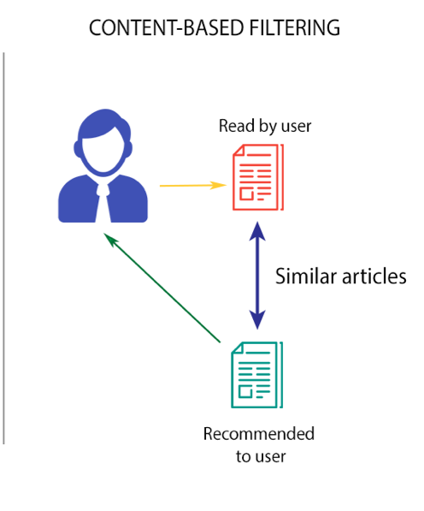
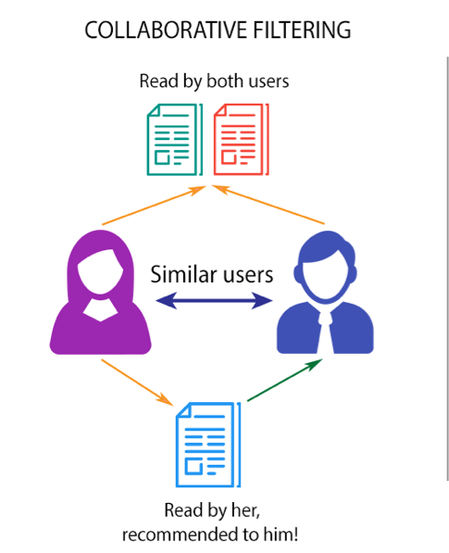
Two faces in the recommendation system:
Content
based
Collaborative Filtering
Accurate for users with history
Good for new users
Presenting the top results
Merging the best from the two approaches

Slide 3
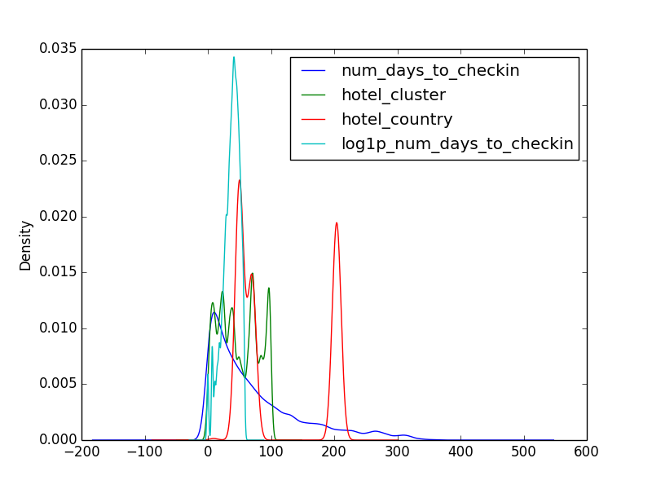
Distribution of different attributes
Most of the attributes follow Gaussian distribution
Preprocessing:
PCA – Principal Component Analysis reduction to bring down the number of attributes from 150 to 3

Slide 4
Content Based Filtering
Used Naïve Bayesian algorithm to predict the hotel cluster for the given instance
All the attributes are assumed to be following Gaussian distribution for calculating probability score

Slide 5
Collaborative filtering
K- Nearest Neighbors:
Approach:
O/p: The top 50 similar users
Matrix Factorization:
I/P: K-nearest neighbors to the target user
Filtering: only similar users who have travelled to the target user’s destination
The top 10 filtered users are passed onto matrix factorization

Slide 6
Extended Matrix Factorization
Gradient descent – to find the local minimum of deviation of predicted form actual value
Fills in missing values
Beta factor- for regularization

Slide 7
Merging results from the two approaches
Content based predicts better – most users have good history and repeated travels
Collaborative- relatively lower accuracy
Merging – more weightage for content based
Final output of prediction – top 5 predictions for the target user

Slide 8
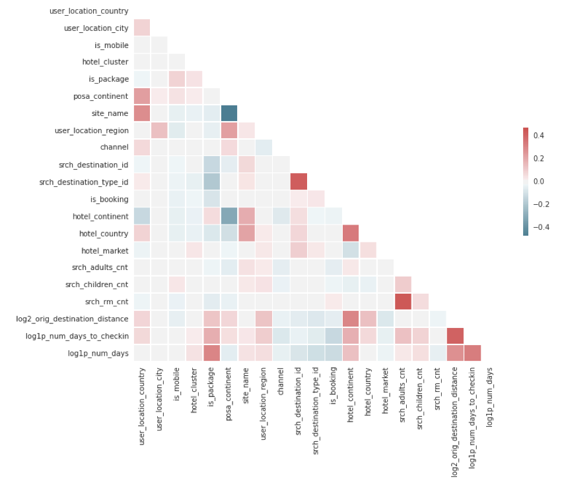
Hypothesis Testing

Slide 9
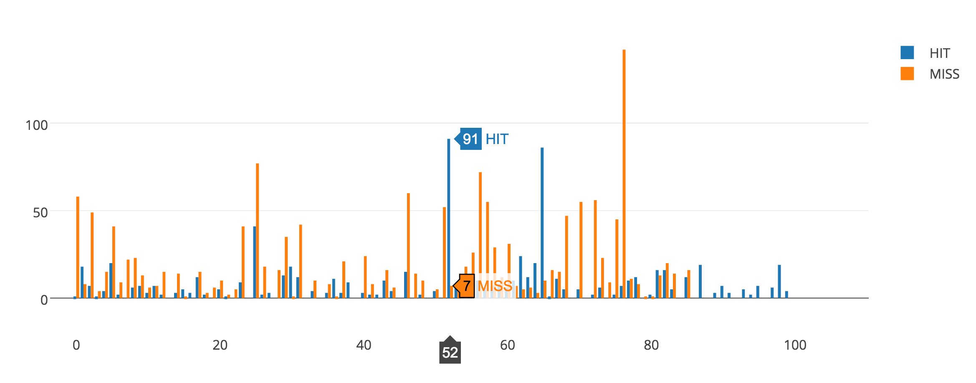
Validating results
Precision.
Calculated for the final results of recommendation system
Score achieved- 0.75
Prediction accuracy if the top 1 result from the recommendation system is matched with the cluster label is around 50%

